Slide 1


Stage Worthy Presentations
Morgan DiCarlo
TEDx Style

Slide 2
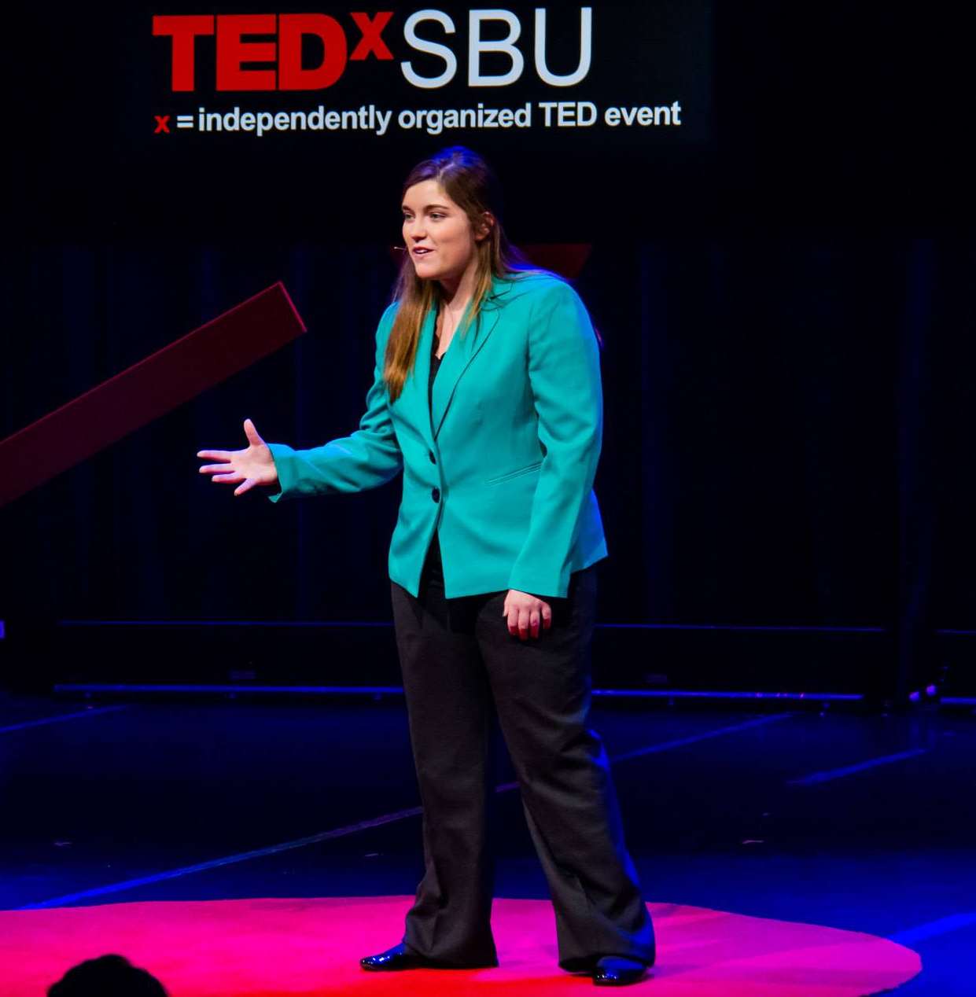
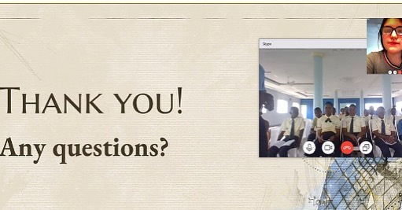
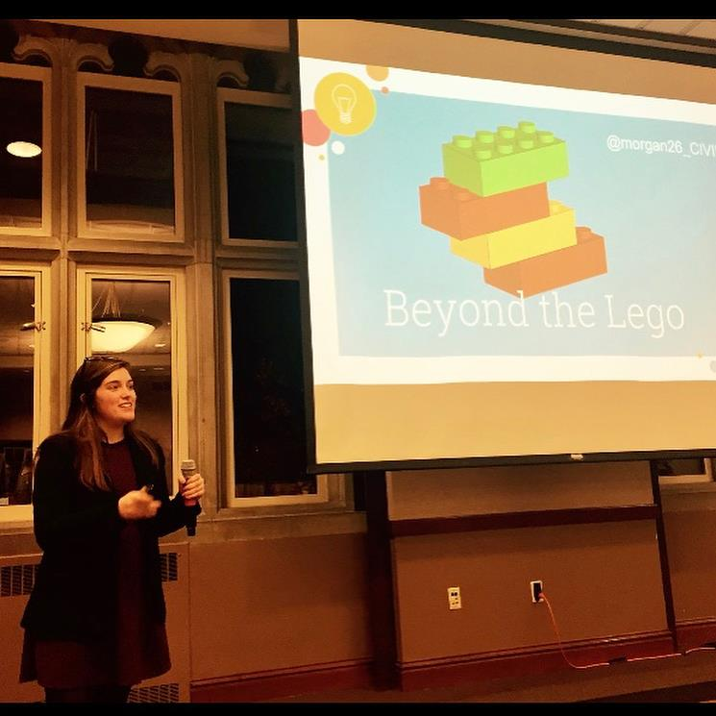

About me
TEDx Speaker
STEM Keynote
Skype Global Educator

Slide 3
Overview
Elements of a TEDtalk
Creating a speech
Story
Idea
Hook
Evidence
Public Speaking Tips
Wrap-Up
Openers and Closers

Slide 4

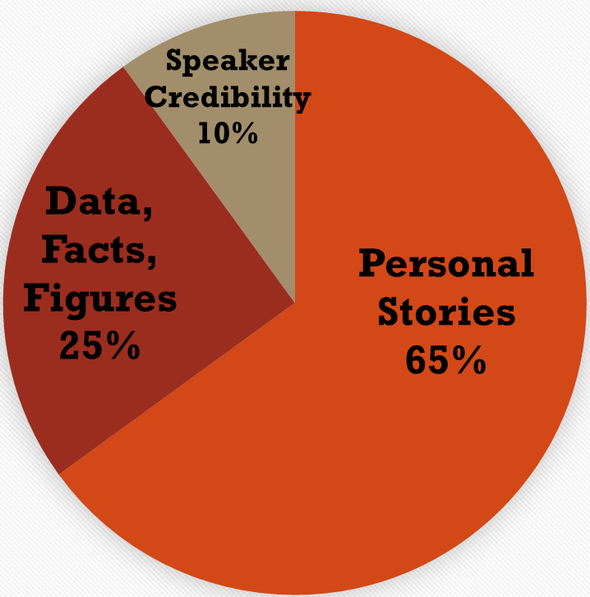
TED Basics
No sales pitch
Good science only
18 minute limit
Technology, Entertainment and Design
…Analysis of 150 hours of TED content
Notes:
65% personal stories
25% data, facts and figures
10% resume builders to reinforce speaker credibility
Analysis of 150 hours of ted content

Slide 5

Beyond TED
We must speak, whether at a conference, give a class lecture or to the community.
Public speaking comes more naturally to some, but strong presentations are achievable for everyone.
Keep your audience in mind when preparing for any kind of talk:
Academic: Defined Jargon
Public: Simplified but Specific
K-12: Jargon Free

Slide 6
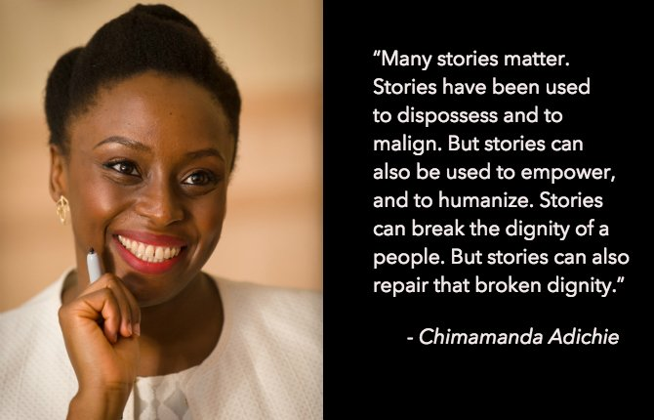
Story over everything
TED’s format is so successful because of story telling
Think about how to reveal information with anecdotes
Connect before content
Your passion draws people in
https://youtu.be/D4pH6TxKzus
The danger of a single story | Chimamanda Ngozi Adichie
TEDx Speaker, 6 million views, sampled by Beyonce!?

Slide 7

Ideas worth spreading
Your singular, badass thing.
Hone in on your idea by asking yourself:
What’s one assumption I’d like to challenge?
What’s a belief of mine that has changed, and why?
What does everyone overlook when they think about my job?
What could I talk about all day?
What do we need to change?

Slide 8
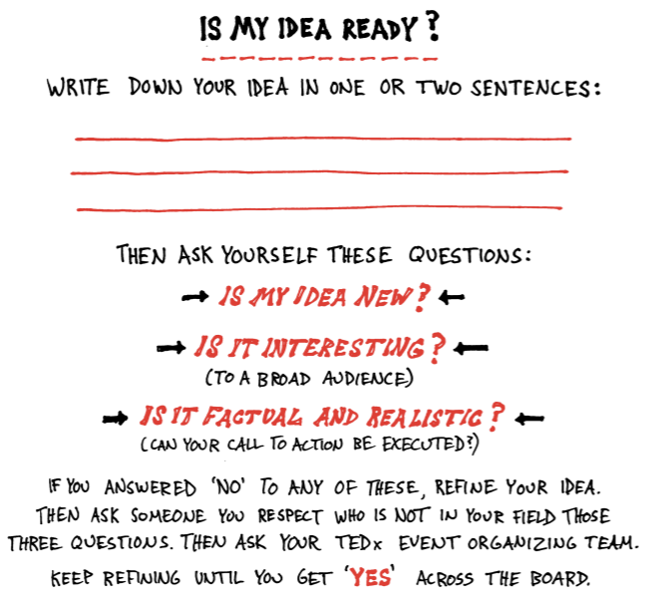
Illustrated TEDx Speaker Guide

Slide 9

An idea is not a theme or catchphrase. It’s narrow and novel.
Example of an empowering curriculum for high school girls
Women’s Rights
“Girl Power!”
Theme
Platitude
Idea

Slide 10

The Hook
According to a study of 2,000 Canadians, human attention span has dropped to just 8 seconds since smart phones were invented. One second short of a goldfish!
The hook is the catchy way to say your idea.
Find the hook by asking yourself:
Why listen?
What is ironic or funny about this topic?
Why did I want to know more about this?
How did I feel the moment before I learned this/IT happened?

Slide 11
Famous TED hooks
“You will live seven and a half minutes longer than you would have otherwise, just because you watched this talk.” - Jane McGonigal, Gaming can make a better world
"Imagine a big explosion as you climb through 3,000 ft. Imagine a plane full of smoke.” - Ric Elias, 3 things I learned while my plane crashed

Slide 12


Gather evidence
To re-create your idea, you’ll need vivid examples, illustrations, stories, facts, questions
Write ideas down, take photos, record your thoughts as sound files, etc.
Find the evidence in:
A snippet of conversation
A quote or metaphor
A childhood story that relates to your idea
A fact, or cluster of data that supports it
A graph or chart
A personal moment in your relationship with the idea
A physical object that will help your audience understand
E.g.
“Mr. Bates and the magic money”
Pre and post program surveys

Slide 13

The Meat
Stack your evidence in a reasonable order
Create a high-level outline
Write each element on a 3 x 5 card and physically shuffle them to test possible orders.
Or create one slide per element and shuffle in PowerPoint!
Speak out loud: Does it sound right if I tell that story first, then give the fact?
The goal is a simple story that makes the audience understand

Slide 14

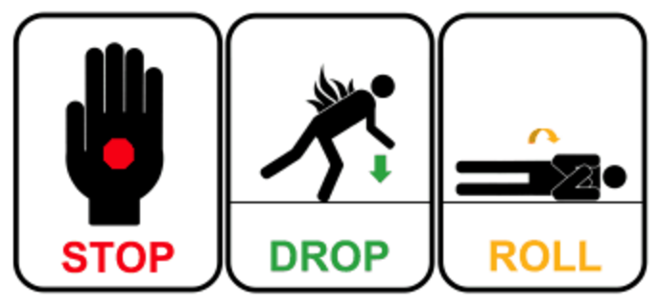

The rule of threes
Reduce complex ideas into easily understood chunks of content.
Give a talk that makes people feel like they're smart and like they want to learn more about the topic
If you are trying to do too much, think about
Which three things are most important?
“The rule of three is a writing principle that suggests that a trio of events or characters is more humorous, satisfying, or effective than other numbers”

Slide 15
Openers Closers
Thought provoking question
Shock the audience
Use visual language like “Imagine”
Call to action
Give them homework
Painting a hopeful future
Famous quote
Connect the dots. Why should this matter to everyone?

Slide 16
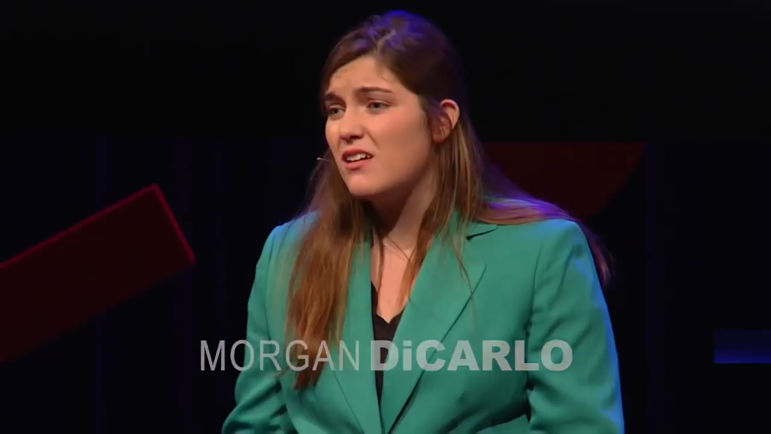
Ending my talk…

Slide 17
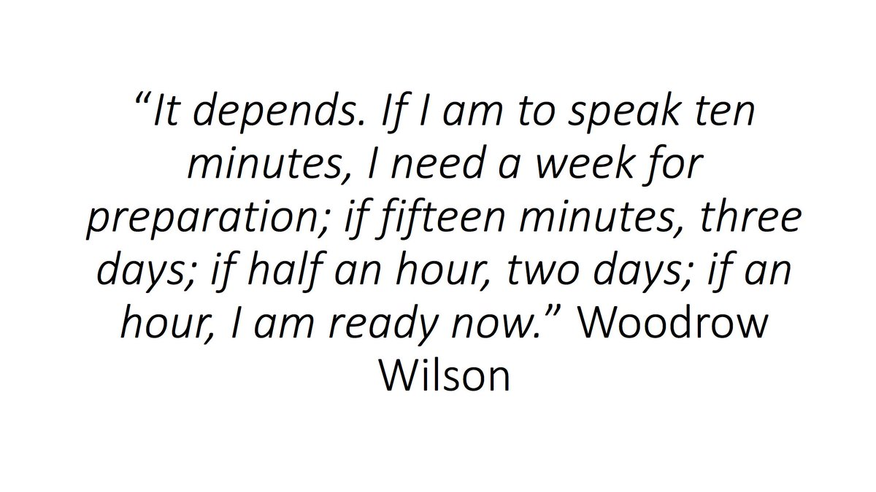

Major Talk: Preparation schedule
4 months before the event’s day: Thesis and basic outline
3 months out: A script or detailed outline due
2 months out: Final draft and two rehearsals
1 month out: Weekly rehearsals
2 weeks out: Daily Rehearsals
1-2 days out: Dress rehearsals
Practice, Practice, Practice

Slide 18
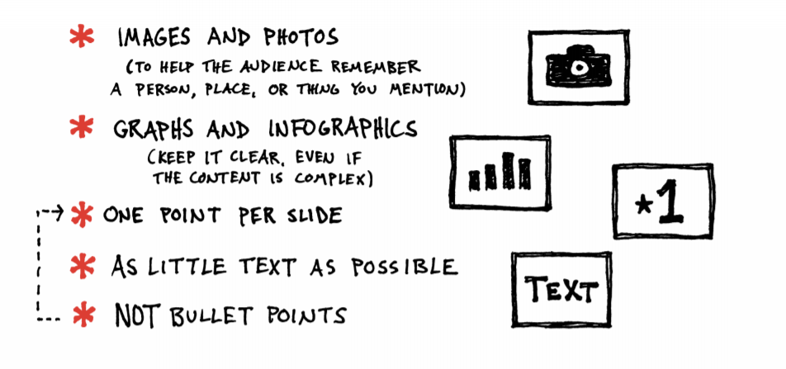
Visuals
People should not be reading anything while trying to listen

Slide 19


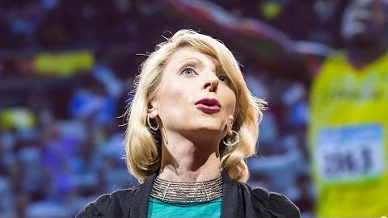
Body Language
Before the talk, shake out your body
DON’T hide behind a podium
Cover some of the stage with a light pace
Never turn your back to the audience
Raise your hands
Look to the person next to you
Repeat after me

Slide 20
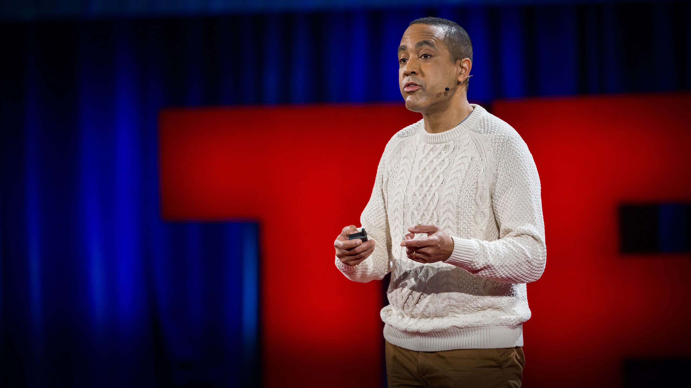



The most popular TED Talkers used an average of 465 hand gestures!
Use your hands, but slow it down
Hands must stay visible
Stay in the strike zone
Open palm gestures
Descriptive gestures
Lýdia Machová

Slide 21
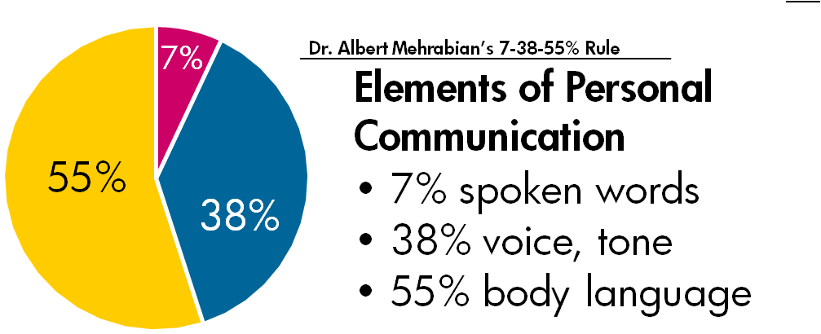

Slide 22
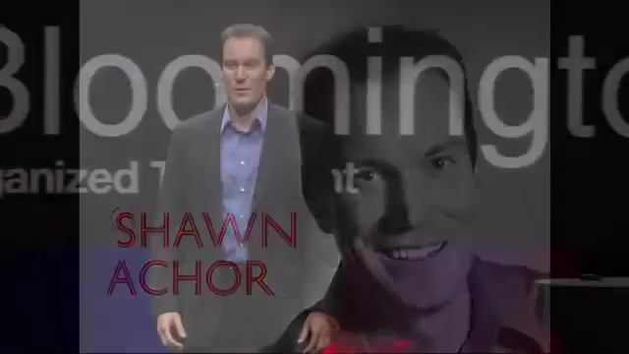
How to do a funny
https://www.youtube.com/watch?v=GXy__kBVq1M

Slide 23
Tips and Tricks
Time record yourself on Voiceapps
Make a talk that sounds like you’re… talking!
Watch a video of yourself practicing
Learn from singers. Speak slowly, use vocal warmups and hydrate

Slide 24
Tips and Tricks
Be Yourself
Do not assume a tone or accent
Smile and look up
Do not read from notes
Rehearse
Practice in the space
Understand tech available to you (clicker, microphone, ticker)
Dress Code
Avoid bold pattens when filmed or photograph
Avoid black and white with stage lighting
Comfortable, low shoes
Skirts from below

Slide 25
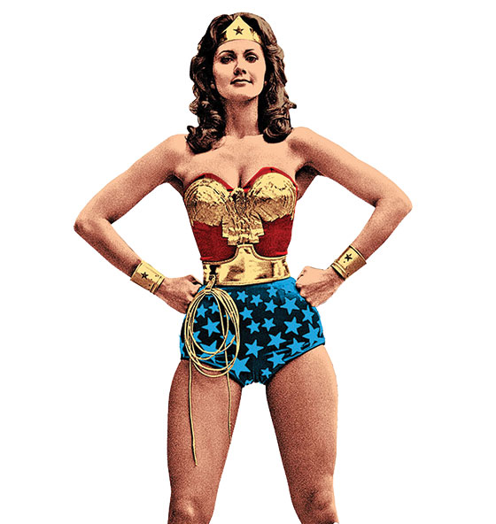

Nerves
Be okay with being scared
I was TERRIFIED !
Barbra Streisand refused to appear on stage for decades because of stage fright.
Excited and nervous is the same feeling
Don’t try to contain all your nervous energy.
Rock a power pose
This Photo by Unknown Author is licensed under CC BY-SA

Slide 26
Expect the unexpected
You may forget a word; someone may drop something backstage or technical difficulty.
Take a pause.

Slide 27
Public Forums
Local
Skype
TED
Nerd Nite Raleigh is:
20 min PowerPoints across topics
Third Thursdays, at a place with beers.
Skype Classroom is:
A free global community that offers talks from Guest Speakers
Local TEDx:
TEDxNCState!
TEDxCaryWomen
TEDxRaleigh
And self-organized!
https://education.microsoft.com/en-us
https://raleigh.nerdnite.com/

Slide 28
So worth it…
Publicize your talk:
~In email signature
~In citation on your CV
Public speaking is TOUGH!
But TED and other recordings are invaluable networking tools
And a great, condensed version of your passion

Slide 29


Slide 30
Sources
The Official TEDx Speaker Guide:
http://storage.ted.com/tedx/manuals/tedx_speaker_guide.pdf
http://storage.ted.com/tedx/manuals/IllustratedTEDxSpeakerGuide.pdf
https://blog.ted.com/12-pieces-of-advice-for-giving-talks-that-have-impact/
https://blog.ted.com/a-ted-speaker-coach-shares-11-tips-for-right-before-you-go-on-stage/
https://www.inc.com/geoffrey-james/11-public-speaking-tips-from-the-best-ted-talks-speakers.html
Gallo,Carmine "The Storyteller's Secret: From TED Speakers To Business Legends, Why Some Ideas Catch On And Others Don’t”
https://visme.co/blog/how-to-start-a-presentation/
https://time.com/3858309/attention-spans-goldfish/
https://www.scienceofpeople.com/hand-gestures/
https://ustudio.com/blog/video-platform/3-things-dr-albert-mehrabian-teaches-us-about-communication-at-work/
TED| How to make stress your friend | Kelly McGonigal
TED| Your body language may shape who you are | Amy Cuddy
TED| The danger of a single story | Chimamanda Ngozi Adichie
TED | Lýdia Machová: The secrets of learning a new language | TED Talk
TEDxBloomington | Shawn Achor | "The Happiness Advantage: Linking Positive Brains to Performance"

